Slide 1
Visual Query Semantics
2022/05/05
https://github.com/Visual-Query-Semantics
Benchmark: Query visual semantics for generative pre-trained visual models

Slide 2
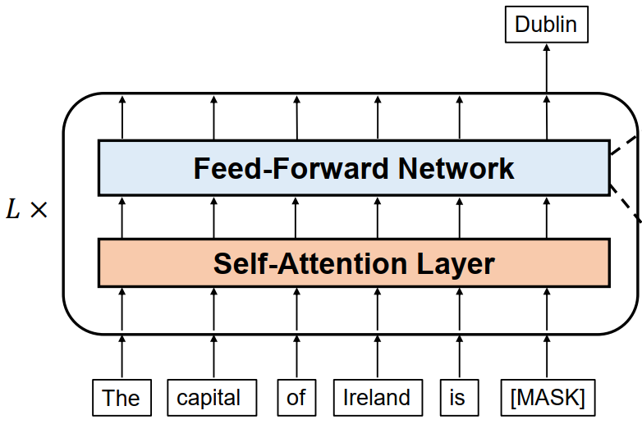
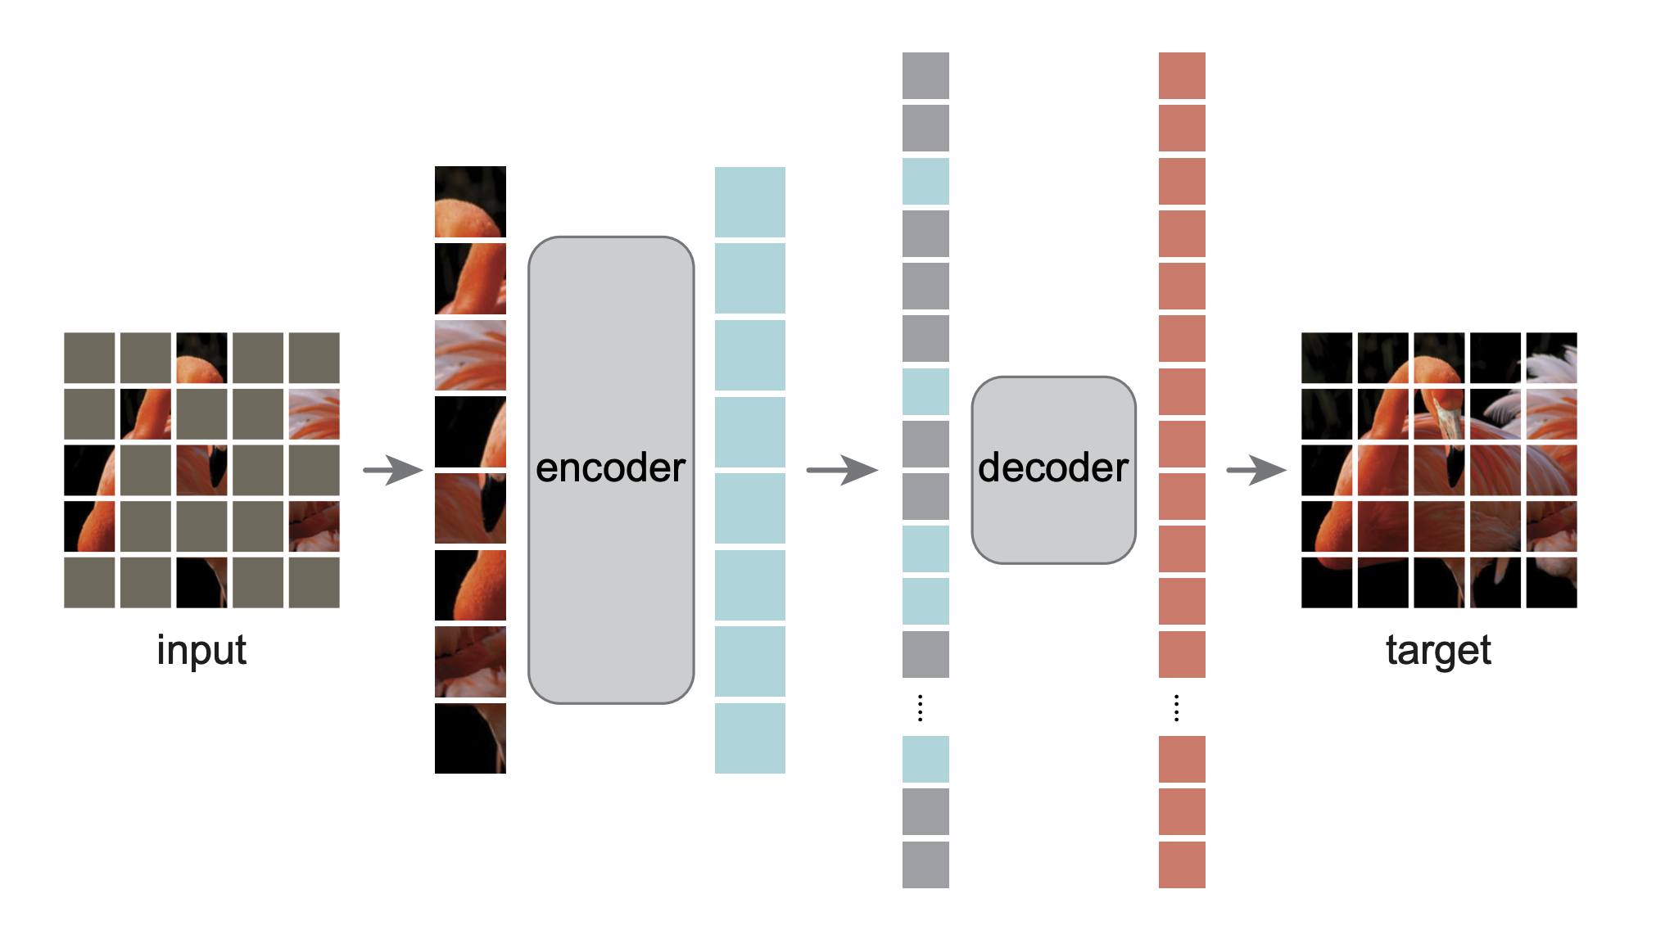
NLP
CV
Masked Language Models
(MLM)
Transformers
Masked Image Models
(MIM)
Generative Pretrained Task
Word Mask
e.g., BERT
Patch Mask
e.g., BEiT, MAE
Mask-and-Reconstruct

Slide 3
Common ground:
masked autoencoding
More concretely, parts of content in input data are masked to learn latent representations from the visible regions by encoder, which are then used to reconstruct content by decoder.
NLP
CV
Masked Language Models
(MLM)
Transformers
Masked Image Models
(MIM)
Generative Pretrained Task
Word Mask
e.g., BERT
Patch Mask
e.g., BEiT, MAE
Mask-and-Reconstruct

Slide 4
Common ground:
masked autoencoding
For the downstream tasks, the encoder is expected to yield robust representation with rich semantic information.
NLP
CV
Masked Language Models
(MLM)
Transformers
Masked Image Models
(MIM)
Generative Pretrained Task
Word Mask
e.g., BERT
Patch Mask
e.g., BEiT, MAE
Mask-and-Reconstruct

Slide 5
Difference points:
Language naturally has semantics highly abstracted by human, where the elemental unit is also discrete.
Yet pixels contained in image merely contain low-level statistics and often present the heavy redundancy due to the continuous property of image.
NLP
CV
Masked Language Models
(MLM)
Transformers
Masked Image Models
(MIM)
Generative Pretrained Task
Word Mask
e.g., BERT
Patch Mask
e.g., BEiT, MAE
Mask-and-Reconstruct

Slide 6
Status quo:
Mainly focus on the performance of downstream tasks. (classification acc, segmentation acc, etc.)
So there is a great need for a benchmark to effectively measure whether the pre-trained visual models can present the following properties: 1) well discretizing continuous image content; 2) containing high visual semantic.
NLP
CV
Masked Language Models
(MLM)
Transformers
Masked Image Models
(MIM)
Generative Pretrained Task
Word Mask
e.g., BERT
Patch Mask
e.g., BEiT, MAE
Mask-and-Reconstruct

Slide 7
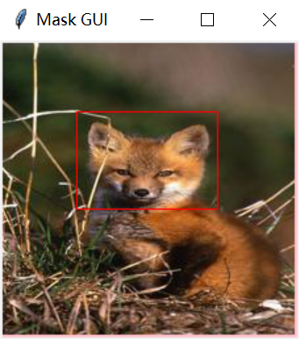
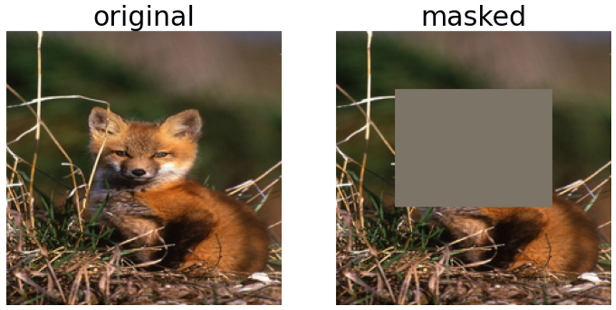
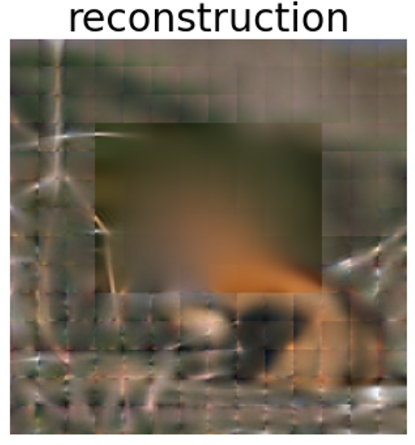
Step#1 : create a visual query by semantics
Semantic Query
fox’s head (masked)
Answer
Step#2 : validate the query answer
fox’s head (not learned)

Slide 8
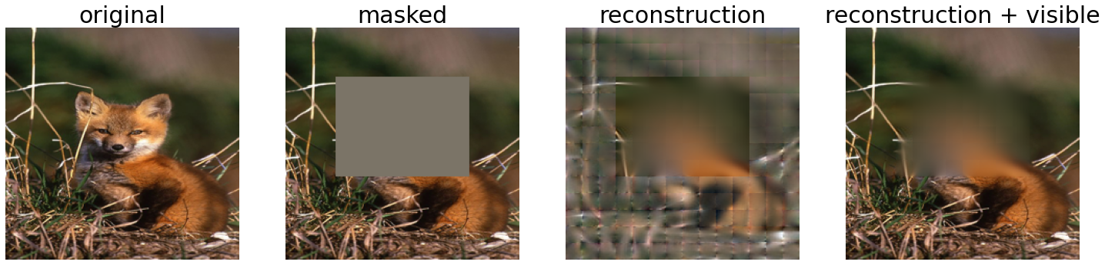
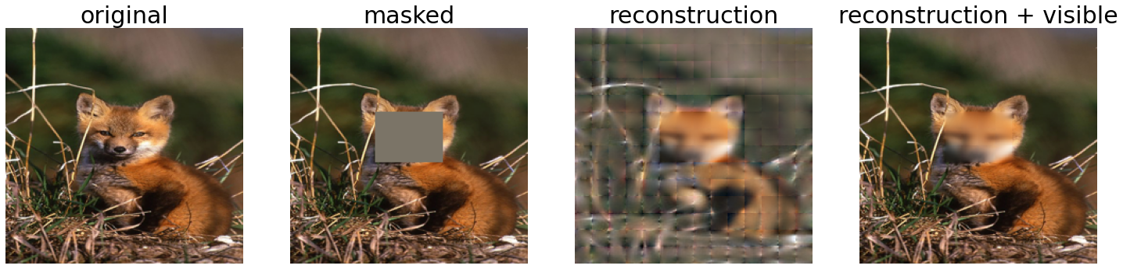
Experimental Results
* Images from ILSVRC2012 (ImageNet 1K) Val and Test
* Pretrained model – ViT Base (MAE) patch16
fox’s head (not learned)
fox’s face (learned)

Slide 9
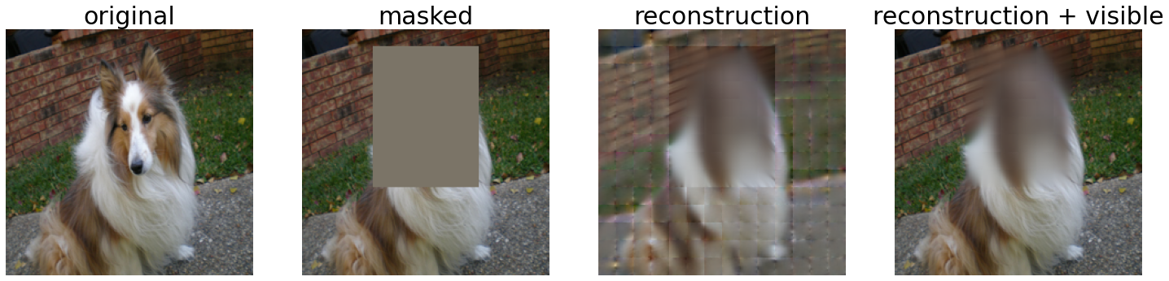
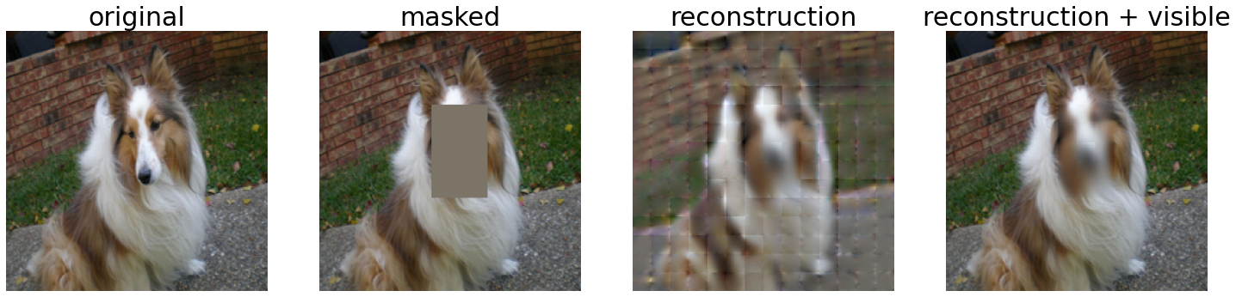
Experimental Results
* Images from ILSVRC2012 (ImageNet 1K) Val and Test
* Pretrained model – ViT Base (MAE) patch16
dog’s head (not learned)
dog’s face (learned)

Slide 10
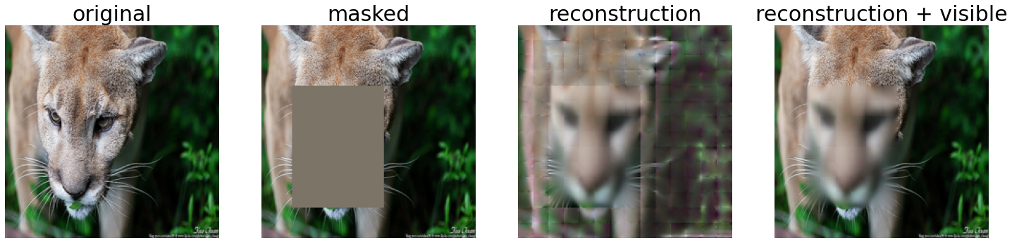
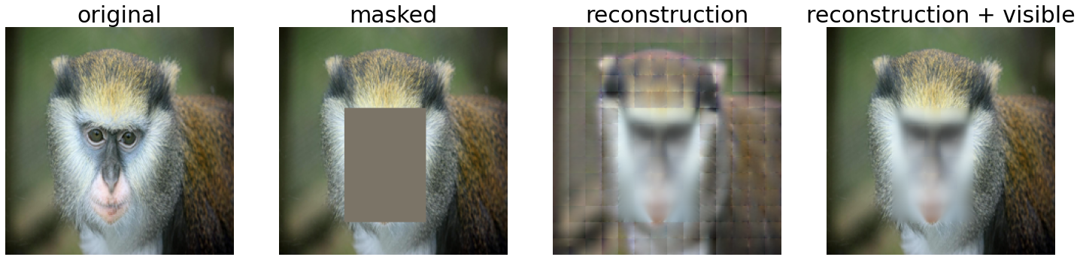
Experimental Results
* Images from ILSVRC2012 (ImageNet 1K) Val and Test
* Pretrained model – ViT Base (MAE) patch16
cougar’s face (learned)
monkey’s face (learned)

Slide 11
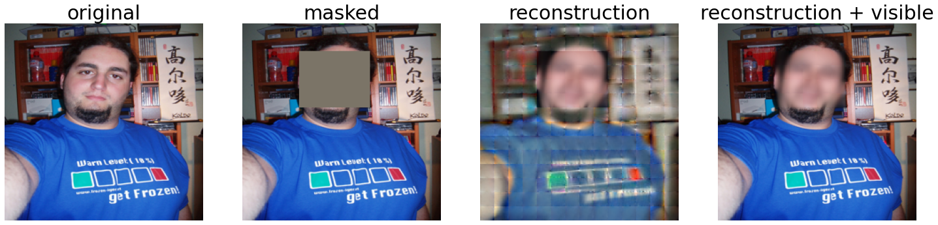
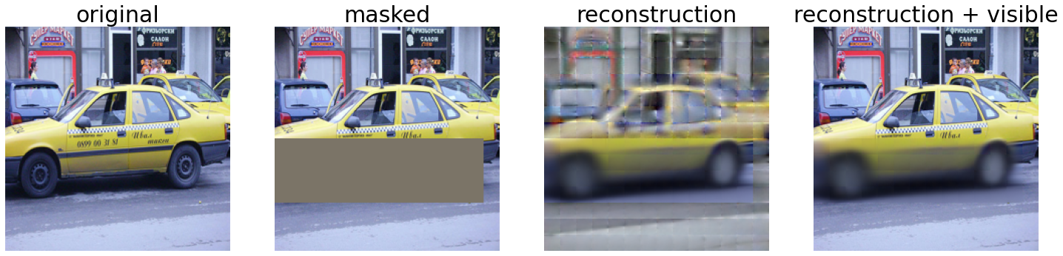
Experimental Results
* Images from ILSVRC2012 (ImageNet 1K) Val and Test
* Pretrained model – ViT Base (MAE) patch16
man’s face (learned)
taxi’s wheels (learned)

Slide 12
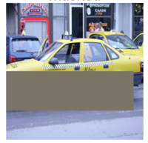
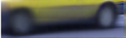

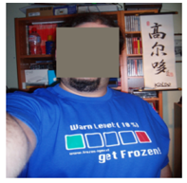


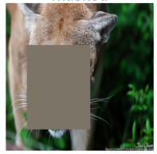
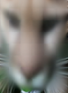

TODO#1 present a vision semantic query dataset for pretrained models
* give more semantic assess to the pretrained paradigm.
current metrics mainly on downstream evaluation (classification acc, etc.)
intuition: more vision semantic knowledge -> more general downstream power
Query Answer
Ground Truth
Semantic Query
Contrast
Semantic Query
Contrast
Semantic Query
Contrast

Slide 13
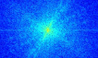
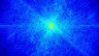
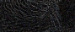

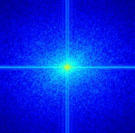
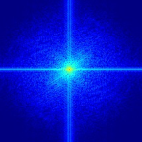

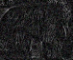
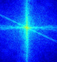
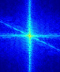
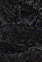
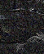
TODO#2 present a vision semantic query benchmark for pretrained models
* Intuition: Leverage Intermediate representations with high-level semantics highlighted
Candidate#1 Fourier Spectrum Maps (FSM)
Phase-only
Query Answer
Ground Truth
Contrast
Contrast
Contrast
Notes:
Fourier transformation. First, suggested by many works, high-level semantics of the original signal are naturally preserved in the phase component of Fourier spectrum, while the amplitude component contains low-level statistics. Besides, Fourier basis are orthogonal, which can spontaneously discretize spatial domain content into individual frequency component in Fourier spectrum. Last, each frequency component in Fourier spectrum has the global vision, which of each is also, to put it another way, a high summary of whole image. [1] Structural sparseness and spatial phase alignment in natural scenes.
[2] Phase in speech and pictures.
[3] The importance of phase in signals.
[4] A demonstration of the visual importance and flexibility of spatial frequency amplitude and phase. [5] The Devil is in the Frequency: Geminated Gestalt Autoencoder for Self-Supervised Visual Pre-Training.

Slide 14
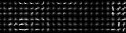
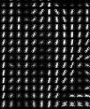

TODO#2 present a vision semantic query benchmark for pretrained models
* Intuition: Leverage Intermediate representations with high-level semantics highlighted
Candidate#2 Oriented Gradients (HOG)
Query Answer
Ground Truth
Contrast
Contrast
Contrast
Notes:
HOG
[1] Masked Feature Prediction for Self-Supervised Visual Pre-Training.

Slide 15
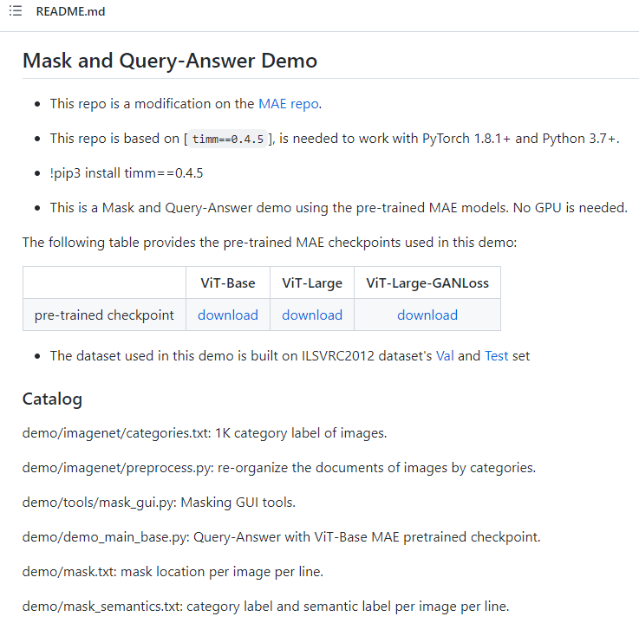
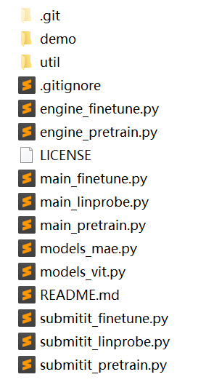
Project Guidance
1# clone repository Demo into local
https://github.com/Visual-Query-Semantics/Demo
2# follow the README.md
3# download ILSVRC12 Val dataset to demo/dataset and unpack here
https://image-net.org/data/ILSVRC/2012/ILSVRC2012_img_val.tar
4# download ILSVRC12 Dev kit to demo/imagenet and unpack here
https://image-net.org/data/ILSVRC/2012/ILSVRC2012_devkit_t12.tar.gz

Slide 16
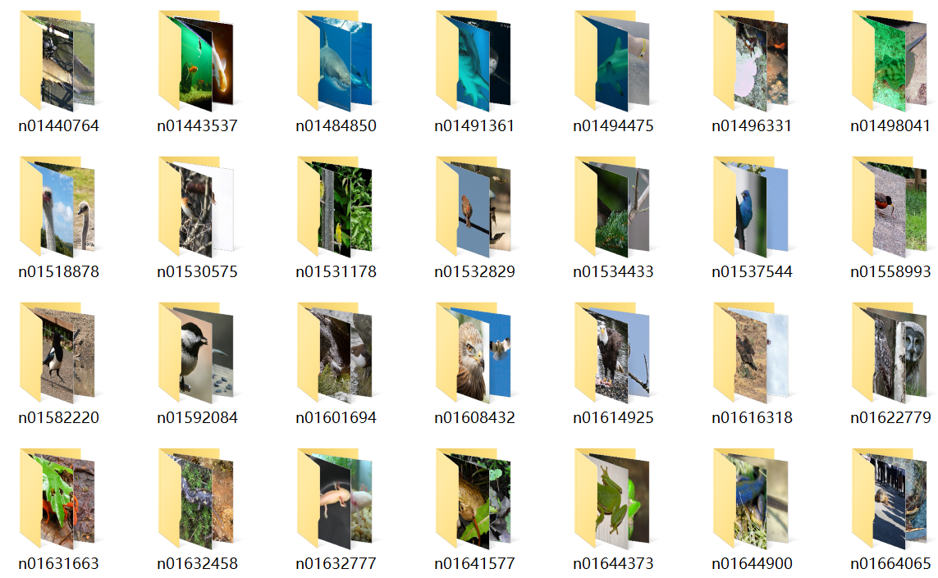
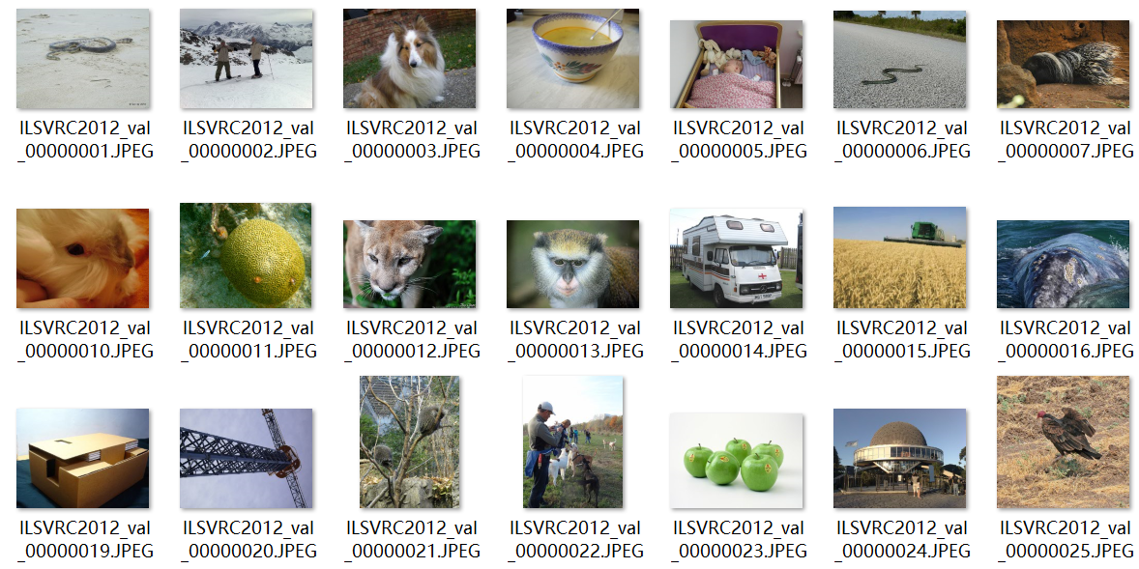
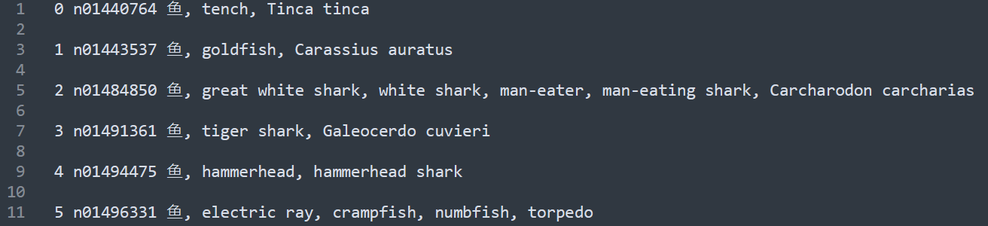
Project Guidance
5# run demo/imagenet/preprocess.py
6# refer to the category labels stored in demo/imagenet/categories

Slide 17
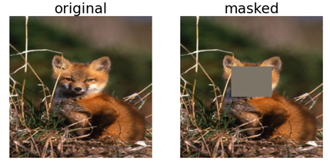
Task#1 find the most discriminative and clear semantics per categories
For example, fox -> face
Next step… label the semantics with masking

